Slide 1

BANGALORE INSTITUTE OF TECHNOLOGY
Department of Computer Science and Engineering
INTER COLLEGE PROJECT COMPETITION
“Physical Exercise Form Correction using Video Processing”
Presented by:
Sachin K Rao
Rohan Savalgi
Vineet K S
Nikita Pyati
Under the Guidance of
Ms. Sunitha K
Assistant Professor, Department of ISE

Slide 2
Agenda
Introduction
Highlights of Literature Survey
System Design
Module Description
Results and Performance Analysis
Conclusion
References
1/20

Slide 3
Introduction
The manner in which human beings conduct their health and fitness can result in numerous benefits and prevention of weight problems, that may successfully lessen the threat of loss of life.
Working out at home is an opportunity to make fitness accessible without requiring lots of equipment. However, it has its drawbacks such as a confined access of fitness know-how, which can lead to severe injuries.
Our solution uses the MediaPipe library, trained and fine-tuned for form detection and correction. This enables users to get accurate and real-time information about their exercise technique, which can help them improve performance and prevent injury.
2/20

Slide 4
Literature Survey
C. Militaru et al. [1] created a database of 2400 images to train a CNN to classify images to monitor and correct the posture during physical exercises.
Y. Agarwal and A. Sharma [2] created a dataset containing a minimum of 5500 snap shots of ten unique yoga poses. Angles of the joints in the human body are extracted using the tf-pose skeleton and used as a feature to implement various machine learning models. However, this approach only works for static images.
A. Badiola and A. Mendez [3], wrote a paper discussing Human Pose Estimation (HPE) and the performance of Deep Learning and its applications in sports and physical exercises.
A. Hannan, M. Shafiq, F. Hussain and I. Pires [4] proposed a fitness equipment set, consisting of a gyroscope and EMG sensory modules for performing T-bar and biceps curl exercise. It guided users to the best possible posture based on sensor readings, wherein they used a KNN classification model to predict and guide the user to perform a specific exercise. However, the usage of wearable devices impacts the user’s experience and potentially their exercise performance.

Slide 5
Problem Statement
Certain types of exercises can be challenging for many people. They may not know how to perform these exercises and engage their muscles.
As a result, people either lose interest in maintaining their fitness, or they perform exercises incorrectly, which can lead to severe injuries.
The alternate approach is to join gyms or fitness centers. However, this requires people to commute from their homes, which may not be feasible due to location and time constraints, thus making home workouts an ideal option.
3/20

Slide 6
Problem Statement
Objectives
The system has to be consistent in detection of wrong postures which might lead to injuries, which finally can lead to improper gains.
Helps in tracking sets and repetitions of exercise. Tracking sets and repetitions can help users to monitor progress and adjust their workout routine as needed.
Helps in maximizing consistent gains. By tracking progress and providing consistent feedback, users can make adjustments to their workout routine in order to maximize gains and improve overall fitness.
3/20

Slide 7
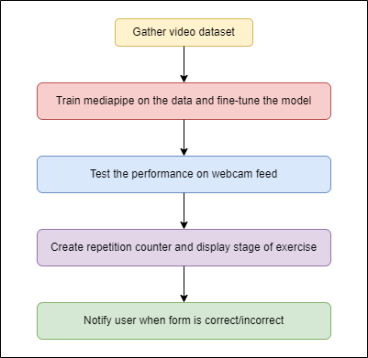
System Design
7/20

Slide 8
Module Description
The dataset used for training is InfiniteRep, which is a synthetic, open-source dataset for fitness and physical therapy (PT) applications.
It includes 1000+ videos of diverse avatars performing multiple repetitions of common exercises.
It includes significant variation in the environment, lighting conditions, avatar demographics, and movement trajectories.
The dataset features 100 videos per exercise, spanning 5 to 10 repetitions each (1,000 videos total).
The main features include working under diverse lighting conditions, varied body shape, skin tones, and clothing.
8/20

Slide 9
Module Description
We first train the MediaPipe model on the InfiniteRep dataset, so that it can be fine-tuned for pose-estimation in different lighting conditions and for different exercises.
The estimated joints and body parts are checked for correctness by the use of functions which calculate the angles between them based on the specific exercise being performed.
For the purpose of this work, we have considered four different exercises, which are push-ups, leg extensions, lunges and bicep curls.
If the user's form is incorrect, the system provides real-time feedback on where the user is making a mistake.
This feedback is in the form of visual cues such as highlighting the correct and incorrect body positions and displaying a text message on how to correct it.
9/20

Slide 10
Module Description
10/20

Slide 11
Module Description
In order to effectively locate the source of the incorrect posture for each exercise, we only consider the landmarks and connections between them that are relevant to that particular exercise.
When the user’s form is deemed correct, the connections are displayed in green colour along with a message reiterating that it is correct.
On the other hand, when the user’s form is incorrect, the connections are displayed in red with a message reiterating the same.
The number of repetitions performed by the user along with their current stage of exercise is also displayed.
When the angle between the relevant joints for a given exercise cross a certain threshold, the repetition counter is incremented and the stage of the exercise is updated.
11/20

Slide 12
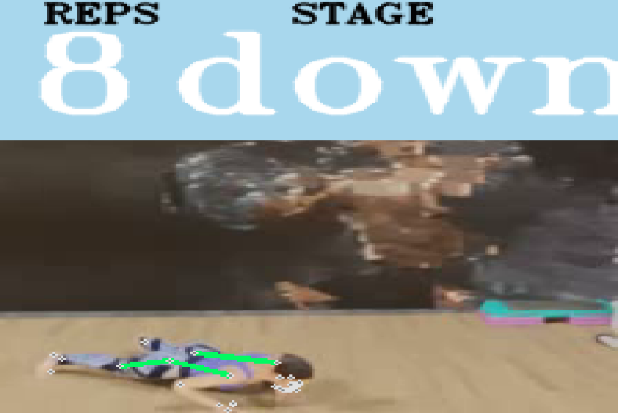
Results and Performance Analysis

Slide 13
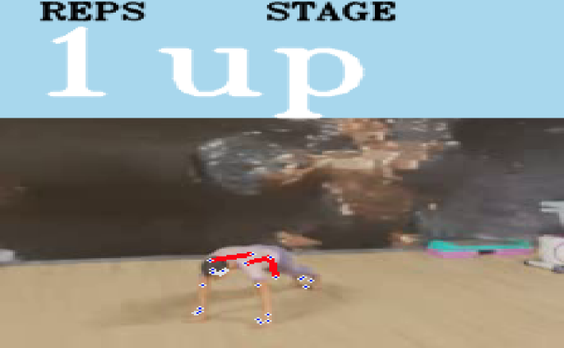
Results and Performance Analysis

Slide 14
Results and Performance Analysis
The results of our evaluation showed that the MediaPipe model used in this system achieved a high accuracy rate, with an MPJPE of 3.2 cm and a PCK of 95.6% on the InfiniteRep dataset.
This indicates that the model is able to accurately estimate body poses and key joints in exercises, making it well-suited for use in a physical exercise form correction system.

Slide 15
Conclusion
By providing accurate and real-time feedback on their form, users can correct their posture and achieve better workouts.
The MediaPipe model used in this system has been fine-tuned for real-time pose estimation and achieved high accuracy on the InfiniteRep dataset.
The system has the potential to be expanded to other exercises and sports, making it a valuable tool for fitness enthusiasts and athletes.
The project focuses to display timely and regular achievements and milestones when a certain number of workouts are completed accurately and correctly.
15/20

Slide 16
References
[1] Cristian Militaru, Maria-Denisa Militaru, and Kuderna-Iulian Benta. Physical exercise form correction using neural networks. In Companion Publication of the 2020 International Conference on Multimodal Interaction, pages 240–244, 2020.
[2] Yash Agrawal, Yash Shah, and Abhishek Sharma. Implementation of machine learning technique for identification of yoga poses. In 2020 IEEE 9th international conference on communication systems and network technologies (CSNT), pages 40–43. IEEE, 2020.
[3] Aritz Badiola-Bengoa and Amaia Mendez-Zorrilla. A systematic review of the application of camera-based human pose estimation in the field of sport and physical exercise. Sensors, 21(18):5996, 2021.
[4] Abdul Hannan, Muhammad Zohaib Shafiq, Faisal Hussain, and Ivan Miguel Pires. A portable smart fitness suite for real-time exercise monitoring and posture correction. Sensors, 21(19):6692, 2021.
[5] Muhammad Usman Ashraf, Abdul Hannan, Sehrish Munawar Cheema, Zahra Ali, Abdulraheem Alofi, et al. Detection and tracking contagion using iot-edge technologies: Confronting covid-19 pandemic. In 2020 international conference on electrical, communication, and computer engineering (ICECCE), pages 1–6. IEEE, 2020.
21

